Slide 1
Spring Boot
Spring Boot is a project that is built on the top of the Spring Framework. It provides an easier and faster way to set up, configure, and run both simple and web-based applications.
It is a Spring module that provides the RAD (Rapid Application Development) feature to the Spring Framework.
It is used to create a stand-alone Spring-based application that you can just run because it needs minimal Spring configuration.

Slide 2
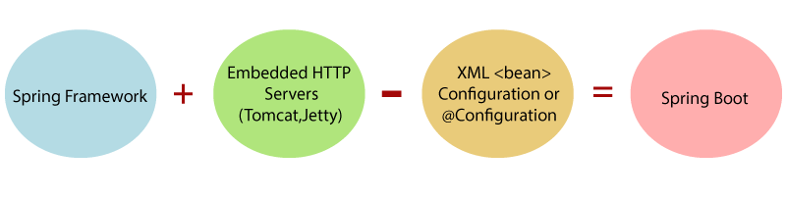

Slide 3
SpringApplication:
The SpringApplication is a class that provides a convenient way to bootstrap a Spring application. It can be started from the main method. We can call the application just by calling a static run() method.
public static void main(String[] args)
{
SpringApplication.run(ClassName.class, args);
}
Spring Boot Version:
Java: Spring Boot 2.2.1

Slide 4
Spring Boot Architecture:
Spring Boot is a module of the Spring Framework. It is used to create stand-alone, production-grade Spring Based Applications with minimum efforts. It is developed on top of the core Spring Framework.
The Spring Boot Architecture, we must know the different layers and classes present in it. There are four layers in Spring Boot are as follows:
Presentation Layer
Business Layer
Persistence Layer
Database Layer

Slide 5
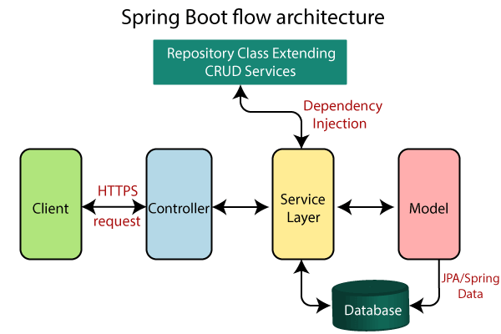
Spring Boot Flow Architecture:

Slide 6
Spring Initializr:
Spring Initializr is a web-based tool provided by the Pivotal Web Service. With the help of Spring Initializr, we can easily generate the structure of the Spring Boot Project. It offers extensible API for creating JVM-based projects.
Generating a Project:
Project: It defines the kind of project. We can create either Maven Project or Gradle Project. We will create a Maven Project throughout the tutorial.
Language: Spring Initializr provides the choice among three languages Java, Kotlin, and Groovy. Java is by default selected.
Spring Boot: We can select the Spring Boot version. The latest version is 2.2.2.
Project Metadata: It contains information related to the project, such as Group, Artifact, etc. Group denotes the package name; Artifact denotes the Application name. The default Group name is com.example, and the default Artifact name is demo.
Dependencies: Dependencies are the collection of artifacts that we can add to our project.

Slide 7
Annotations:
@Required: It applies to the bean setter method. It indicates that the annotated bean must be populated at configuration time with the required property, else it throws exception BeanInitilizationException.
@Autowired: Spring provides annotation-based auto-wiring by providing @Autowired annotation. It is used to autowire spring bean on setter methods, instance variable, and constructor. When we use @Autowired annotation, the spring container auto-wires the bean by matching data-type.
@Configuration: It is a class-level annotation. The class annotated with @Configuration used by Spring Containers as a source of bean definitions.
@ComponentScan: It is used when we want to scan a package for beans. It is used with the annotation @Configuration. We can also specify the base packages to scan for Spring Components.
@Bean: It is a method-level annotation. It is an alternative of XML <bean> tag. It tells the method to produce a bean to be managed by Spring Container.
@Component: It is a class-level annotation. It is used to mark a Java class as a bean. A Java class annotated with @Component is found during the classpath. The Spring Framework pick it up and configure it in the application context as a Spring Bean.

Slide 8
@EnableAutoConfiguration: It auto-configures the bean that is present in the classpath and configures it to run the methods. The use of this annotation is reduced in Spring Boot 1.2.0 release because developers provided an alternative of the annotation, i.e. @SpringBootApplication.
@RequestMapping: It is used to map the web requests. It has many optional elements like consumes, header, method, name, params, path, produces, and value. We use it with the class as well as the method.
@GetMapping: It maps the HTTP GET requests on the specific handler method. It is used to create a web service endpoint that fetches It is used instead of using: @RequestMapping(method = RequestMethod.GET)
@PostMapping: It maps the HTTP POST requests on the specific handler method. It is used to create a web service endpoint that creates It is used instead of using: @RequestMapping(method = RequestMethod.POST)
@PutMapping: It maps the HTTP PUT requests on the specific handler method. It is used to create a web service endpoint that creates or updates It is used instead of using: @RequestMapping(method = RequestMethod.PUT)

Slide 9
@DeleteMapping: It maps the HTTP DELETE requests on the specific handler method. It is used to create a web service endpoint that deletes a resource. It is used instead of using: @RequestMapping(method = RequestMethod.DELETE)
@PatchMapping: It maps the HTTP PATCH requests on the specific handler method. It is used instead of using: @RequestMapping(method = RequestMethod.PATCH)
@RequestBody: It is used to bind HTTP request with an object in a method parameter. Internally it uses HTTP MessageConverters to convert the body of the request. When we annotate a method parameter with @RequestBody, the Spring framework binds the incoming HTTP request body to that parameter.
@ResponseBody: It binds the method return value to the response body. It tells the Spring Boot Framework to serialize a return an object into JSON and XML format.
@PathVariable: It is used to extract the values from the URI. It is most suitable for the RESTful web service, where the URL contains a path variable. We can define multiple @PathVariable in a method.

Slide 10
@RequestParam: It is used to extract the query parameters form the URL. It is also known as a query parameter. It is most suitable for web applications. It can specify default values if the query parameter is not present in the URL.
@RequestHeader: It is used to get the details about the HTTP request headers. We use this annotation as a method parameter. The optional elements of the annotation are name, required, value, defaultValue. For each detail in the header, we should specify separate annotations. We can use it multiple time in a method
@RestController: It can be considered as a combination of @Controller and @ResponseBody annotations. The @RestController annotation is itself annotated with the @ResponseBody annotation. It eliminates the need for annotating each method with @ResponseBody.
@RequestAttribute: It binds a method parameter to request attribute. It provides convenient access to the request attributes from a controller method. With the help of @RequestAttribute annotation, we can access objects that are populated on the server-side.

Slide 11
Spring Boot Application Properties:
Spring Boot Framework comes with a built-in mechanism for application configuration using a file called application.properties. It is located inside the src/main/resources folder.
Example of application.properties:
#configuring application name
spring.application.name = demoApplication
#configuring port
server.port = 8081

Slide 12
Spring Boot Starters:
Spring Boot provides a number of starters that allow us to add jars in the classpath. Spring Boot built-in starters make development easier and rapid. Spring Boot Starters are the dependency descriptors.
In the Spring Boot Framework, all the starters follow a similar naming pattern: spring-boot-starter-*, where * denotes a particular type of application. For example, if we want to use Spring and JPA for database access, we need to include the spring-boot-starter-data-jpa dependency in our pom.xml file of the project.
Third-Party Starters:
We can also include third party starters in our project. But we do not use spring-boot-starter for including third party dependency. The spring-boot-starter is reserved for official Spring Boot artifacts. The third-party starter starts with the name of the project. For example, the third-party project name is abc, then the dependency name will be abc-spring-boot-starter.

Slide 13
Spring Boot Starter Parent:
The spring-boot-starter-parent is a project starter. It provides default configurations for our applications. It is used internally by all dependencies. All Spring Boot projects use spring-boot-starter-parent as a parent in pom.xml file.
Spring Boot Starter Web:
Starter of Spring web uses Spring MVC, REST and Tomcat as a default embedded server. The single spring-boot-starter-web dependency transitively pulls in all dependencies related to web development. It also reduces the build dependency count.
There are two important features of spring-boot-starter-web:
It is compatible for web development
Auto configuration

Slide 14
Spring Boot JPA:
What is JPA?
JPA stands for Java Persistence API.
It's a Java specification for handling relational data in Java applications.
JPA simplifies the interaction between Java objects/classes and relational databases.
It follows Object-Relational Mapping (ORM) principles.
Why use JPA?
JPA simplifies database programming compared to traditional JDBC and SQL.
It represents data using Java objects, making it easier to work with.
With JPA, you don't need to write database-specific SQL queries.
It offers features like querying data using Java objects (JPQL), managing transactions, and more.

Slide 15
Features of JPA:
Provides repository and object-mapping abstraction.
Supports cross-store persistence, allowing data to be stored in multiple data stores.
Generates queries dynamically from method names.
Supports transparent auditing and custom repository code integration.
Easy integration with the Spring Framework.
JPA Architecture:
Consists of Persistence, EntityManagerFactory, EntityManager, Entity, Persistence Unit, EntityTransaction, and Query.
EntityManager manages persistence operations on objects and works with EntityTransaction.
EntityManagerFactory creates and manages EntityManager instances.
Entity represents a persistent object stored in the database.

Slide 16
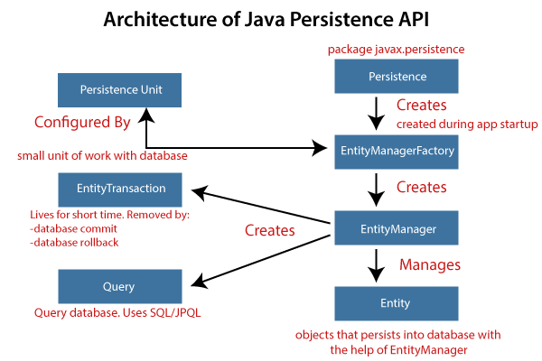

Slide 17
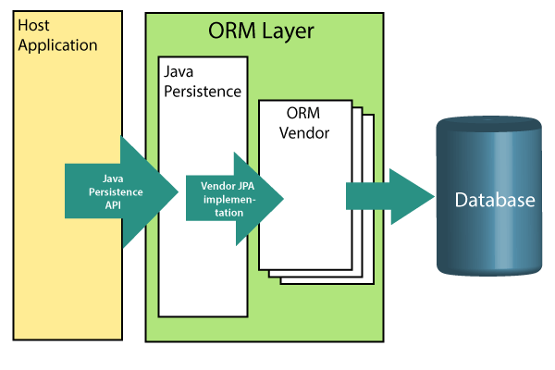
JPA Implementations:
JPA is a Java specification implemented by various ORM frameworks like Hibernate, EclipseLink, DataNucleus, etc.
These frameworks provide the actual implementation of JPA features.
Object-Relational Mapping (ORM):
ORM maps Java objects/classes to database tables and vice versa.
It acts as a bridge between Java application classes/objects and relational database tables/records.
ORM frameworks like Hibernate provide the implementation for JPA.

Slide 18
JPA Versions:
JPA 1.0 was introduced as part of EJB 3.0 in 2006.
The latest version is JPA 2.2, which includes features like Java 8 support, CDI injection in AttributeConverters, and more.
Spring Boot with JPA:
Spring Boot provides starter dependencies like spring-boot-starter-data-jpa for integrating JPA with Spring Boot applications.
With Spring Boot, you can easily connect to databases like Apache Derby using JPA without writing complex configurations.
You define entity classes, repositories, and services to interact with the database, and Spring Boot handles the rest, including dependency injection and transaction management.

Slide 19
Spring Boot CRUD Operations:
CRUD operations stand for Create, Read, Update, and Delete. These are the basic functions used to manage data in a database.
Create: Adding new data to the database.
Read: Retrieving existing data from the database.
Update: Modifying existing data in the database.
Delete: Removing data from the database.
In the context of web applications, CRUD operations correspond to HTTP methods:
POST: Create
GET: Read
PUT/PATCH: Update
DELETE: Delete

Slide 20
Spring Boot CrudRepository:
Spring Boot provides an interface called CrudRepository that contains methods for CRUD operations. It is defined in the package org.springframework.data.repository. It extends the Spring Data Repository interface. It provides generic Crud operation on a repository. If we want to use CrudRepository in an application, we have to create an interface and extend the CrudRepository.
Syntax:
public interface CrudRepository<T,ID> extends Repository<T,ID>
where,
T is the domain type that repository manages.
ID is the type of the id of the entity that repository manages.
For example:
public interface StudentRepository extends CrudRepository<Student, Integer>
{
}
In the above example, we have created an interface named StudentRepository that extends CrudRepository. Where Student is the repository to manage, and Integer is the type of Id that is defined in the Student repository.

Slide 21
Spring Boot Actuator Metrics:
HTTP Requests: Actuator tracks metrics related to incoming HTTP requests, including request count, response times, and status codes. This information helps in understanding the traffic patterns and identifying potential bottlenecks in your application.
Database Queries: Metrics related to database interactions, such as the number of queries executed, their execution times, and error rates, are collected. This allows you to monitor the performance of database operations and optimize them for better efficiency.
Cache Usage: Actuator provides insights into the usage of caching mechanisms in your application. It tracks metrics such as cache hits, misses, and eviction rates, helping you evaluate the effectiveness of caching strategies and optimize cache configurations.
Resource Utilization: Metrics related to CPU usage, memory consumption, and garbage collection activity are also collected. These metrics give you visibility into the resource utilization of your application and help in identifying memory leaks or performance issues.
-----------------------------*------------------------------

